Slide 1


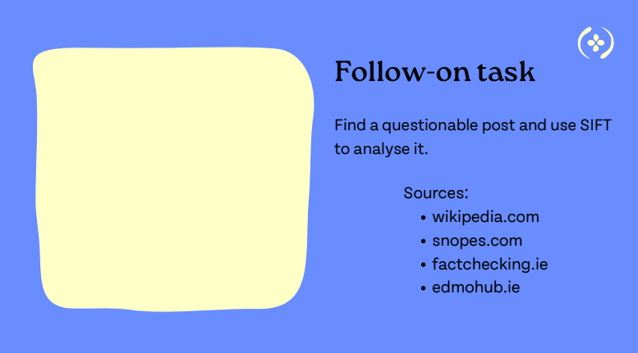
FOLLOW ON TASK

