Slide 1
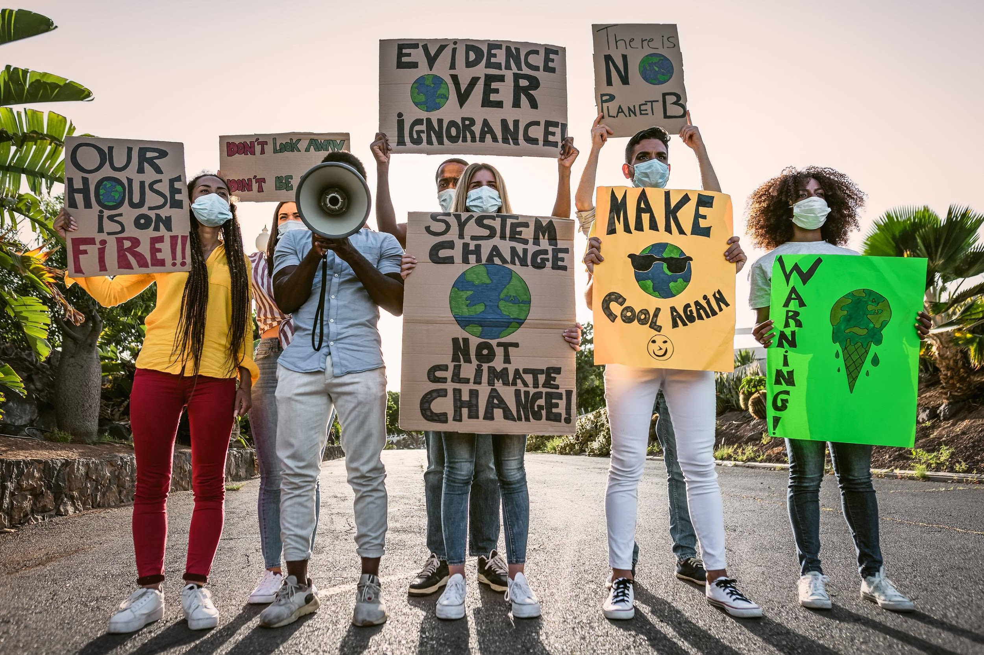



Why aren’t we all activists?
Climate activism and direct action
Climate and Nature Summit 2024
Monday 27th November
Funded by Irish Aid’s Worldwise Global Schools

Slide 2
  We work with schools, communities and businesses to support action for a more sustainable world
  Everyone matters!

Slide 3




Vote with your feet!

Slide 4

Vote with your feet!
Climate change is an important issue

Slide 5

Vote with your feet!
I trust older generations to tackle climate change

Slide 6
Vote with your feet!
I actively campaign and get involved in projects for the climate

Slide 7




86% of young people in Ireland identify climate change as important or very important ¹
78% said they do not trust the older generations to tackle climate change ¹
But
Only 34% are actively campaigning & 24% are involved in a project ²
... so why aren’t we more active?
  Dillon, B., Fahy, F., Reilly K. (2023). Young people and climate change education. Unpublished presentation.
  Eco-Unesco (2020). Youth Climate Voices.

Slide 8
Back to your seat!

Slide 9

What images come to mind when you think of climate activism?
Discuss for 1 minute!

Slide 10
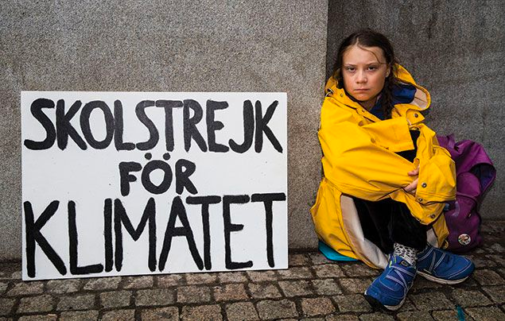
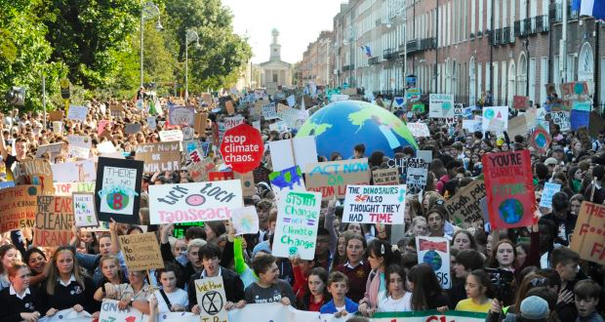
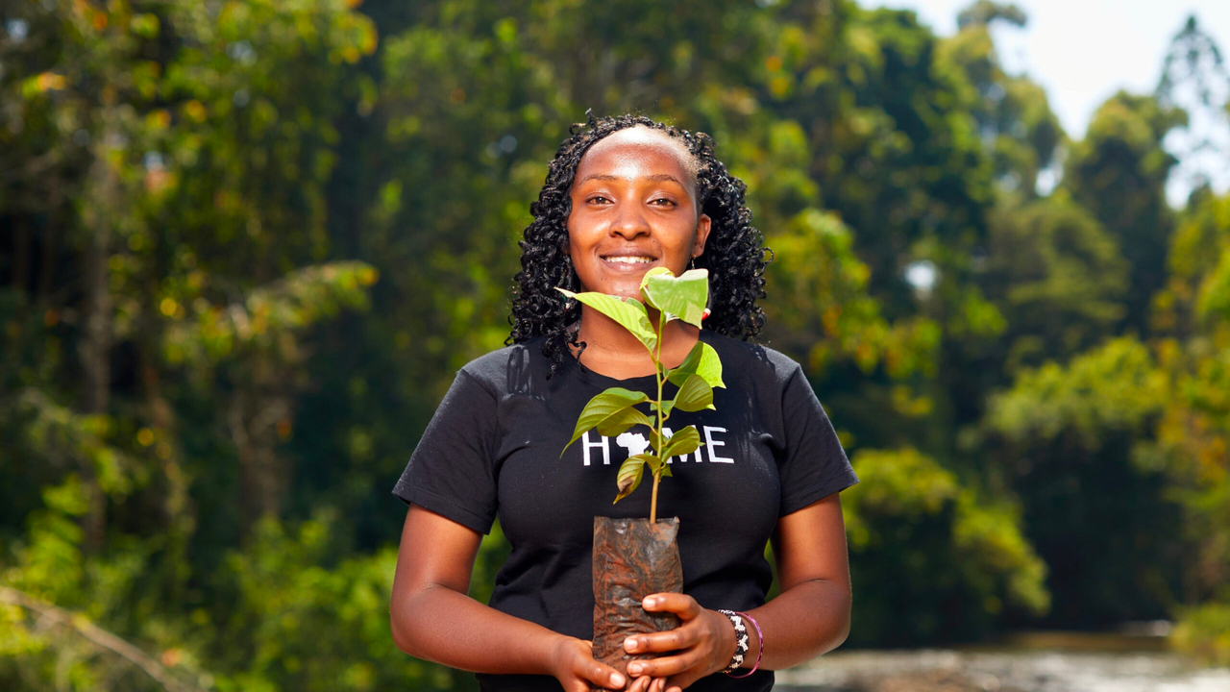
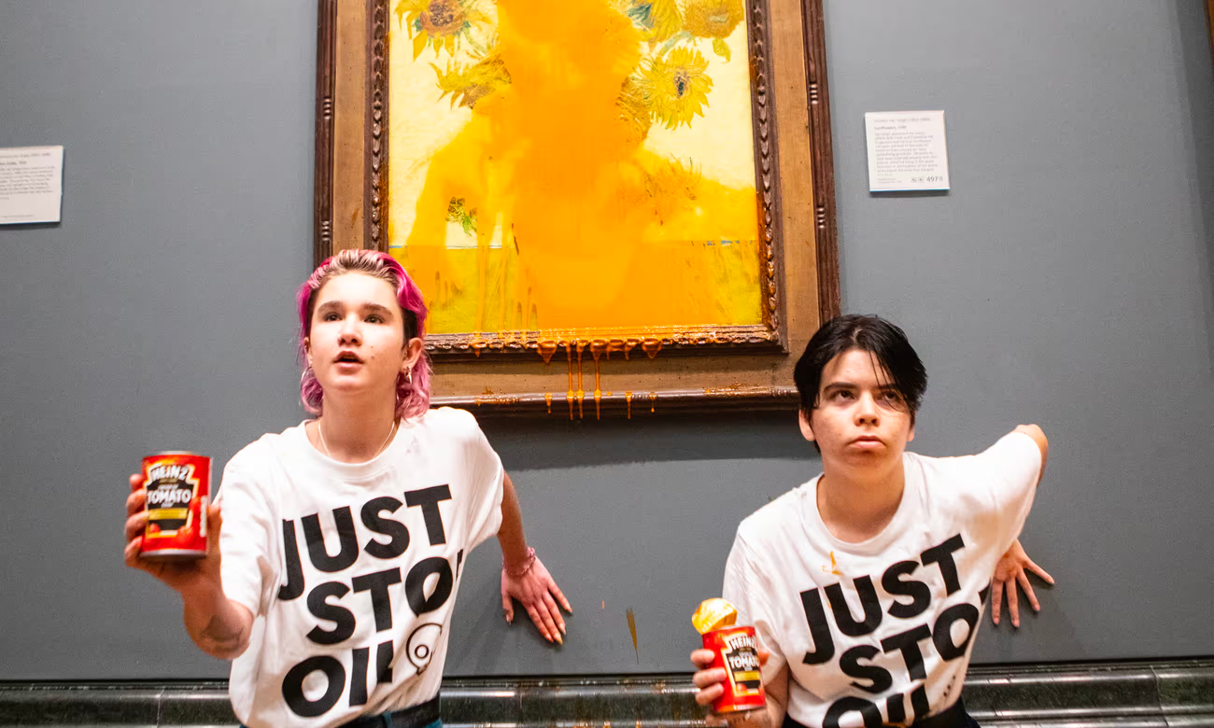
Michael Campanella/The Guardian
Aidan Crawley/The Irish Times
Elizabeth Wathuti / Twitter
Antonio Olmos/The Guardian

Slide 11

Based on these examples, can you think of a definition of climate activism?
How is it different from climate action?
Discuss for 1 minute!

Slide 12
Action vs activism
Climate action
any effort taken to combat climate change and its impacts.
(EULex, 2023)
Reuse
Buy second-hand
Cycling
more
Planting
trees
Activism
Action on behalf of a cause that goes beyond what is conventional or routine (Martin, 2007)
The use of direct and noticeable action to achieve a result, usually a political or social one (Cambridge Dictionary)
Fly less
Notes:
EULex: Climate action refers to efforts taken to combat climate change and its impacts. These efforts involve reducing greenhouse gas emissions (climate mitigation) and/or taking action to prepare for and adjust to both the current effects of climate change and the predicted impacts in the future (climate adaptation).

Slide 13




Direct action can be...
Creative
Disruptive
Non-violent
Collective

Slide 14
What do you stand for?
After each example of
direct action
you will have 15 seconds to decide if this is an effective, useful, or sensible action.
Stand up if it’s something you would do to encourage climate action.
Remain seated if you wouldn’t do it.
We’ll discuss them all at the end!

Slide 15
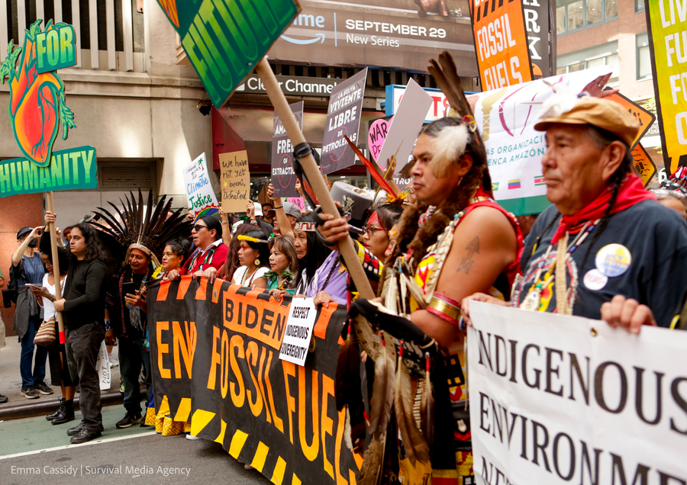
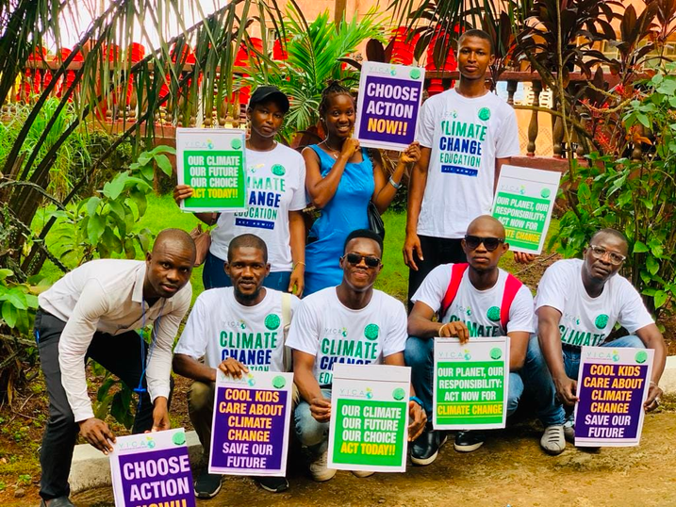

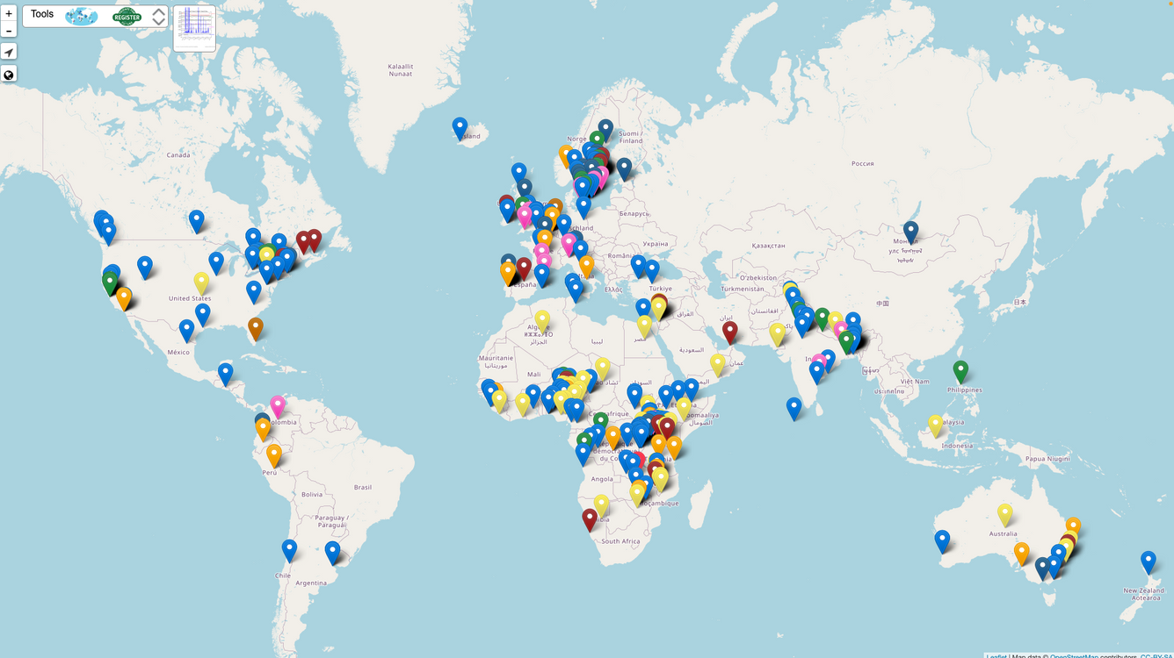
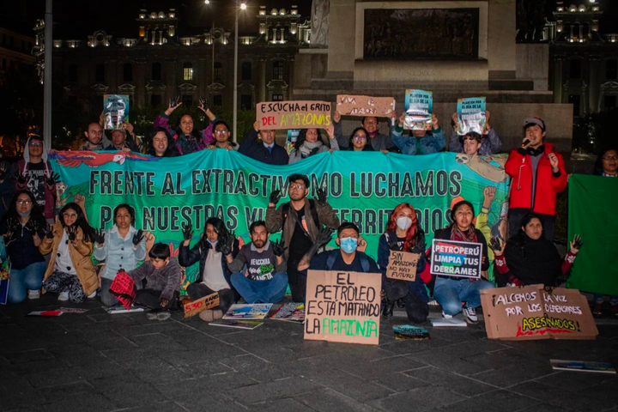
If we unite to overcome and we recognise both our similarities and our differences, we can create a world for all.
Saoirse Exton, Fridays for Future Ireland
Fridays for Future, U.S.
Fridays for Future Sierra Leone
Protests & strikes
Fridays for Future Peru
Fridays for Future
Notes:
Sierra Leone's dynamic Youth Climate Activists are at the forefront of an educational revolution! They're fervently campaigning for climate Education be a fundamental part of the curriculum, ensuring that every student learns the critical skills needed to address our planet's challenges.
These dedicated young leaders are not only raising awareness but also pushing for hands-on environmental initiatives within schools. They're promoting sustainability, conservation, and climate resilience, fostering a new generation of eco-conscious citizens who will safeguard the Earth's futureProtests, rallies, strikes, marches

Slide 16
Fridays for Future Peru
Fridays for Future, U.S.
Fridays for Future Sierra Leone
Protests & strikes
Stand up if you would
join a strike or protest
to support climate action.
Remain seated if not.
Notes:
Sierra Leone's dynamic Youth Climate Activists are at the forefront of an educational revolution! They're fervently campaigning for climate Education be a fundamental part of the curriculum, ensuring that every student learns the critical skills needed to address our planet's challenges.
These dedicated young leaders are not only raising awareness but also pushing for hands-on environmental initiatives within schools. They're promoting sustainability, conservation, and climate resilience, fostering a new generation of eco-conscious citizens who will safeguard the Earth's futureProtests, rallies, strikes, marches

Slide 17

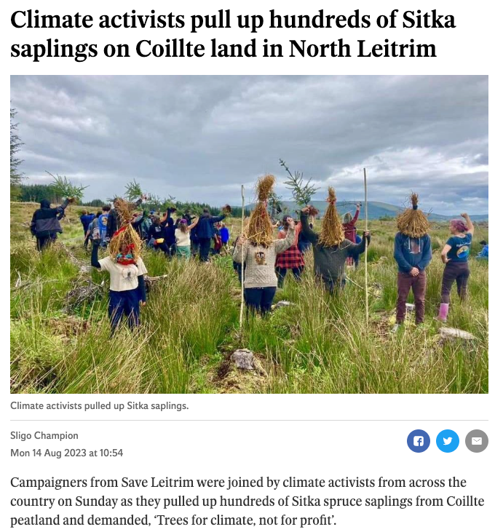
The most effective protest is a disruptive one.
[T]here’s a big harm happening in the world that is pushed to the background. And if we don’t deal with it properly, the global temperature will disrupt life beyond all measures that we have.
Dale Vince, Just Stop Oil
Disruptions
Mike Egerton/PA
We want climate action, we want tree-planting, but we urgently need a shift away from the focus on timber production towards native natural woodlands of broadleaf trees.
Coillte has lost our trust. We’ve been campaigning for years but the Government hasn’t listened.
Brian Smyth, Save Letrim
Irish Independent
Notes:
4 activists in a circle locked on at Barton Moss

Slide 18
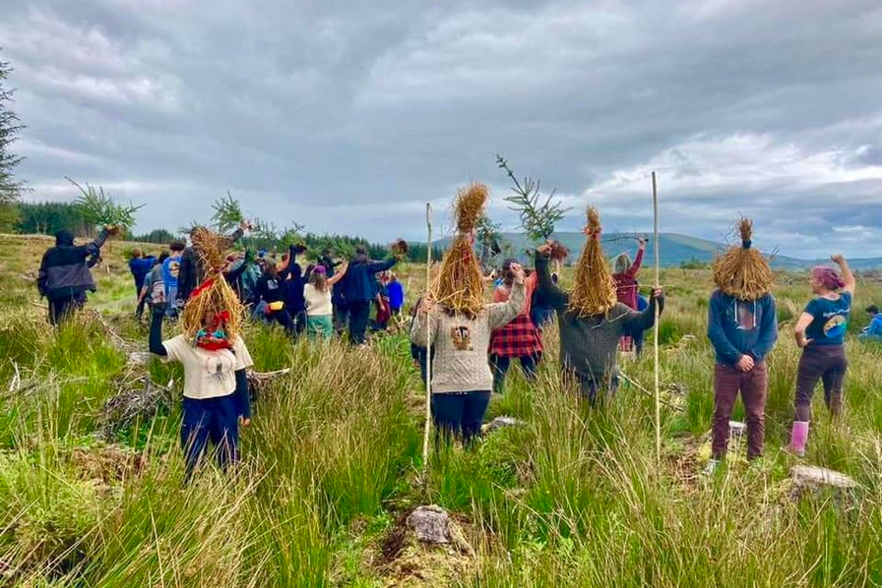
Disruptions
Irish Independent
Stand up if you would
cause a disruption
to support climate action.
Remain seated if not.
Notes:
4 activists in a circle locked on at Barton Moss

Slide 19
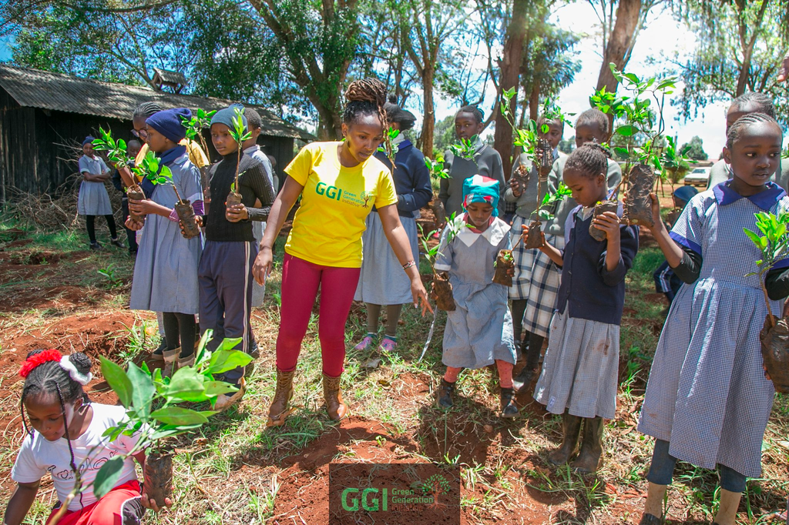
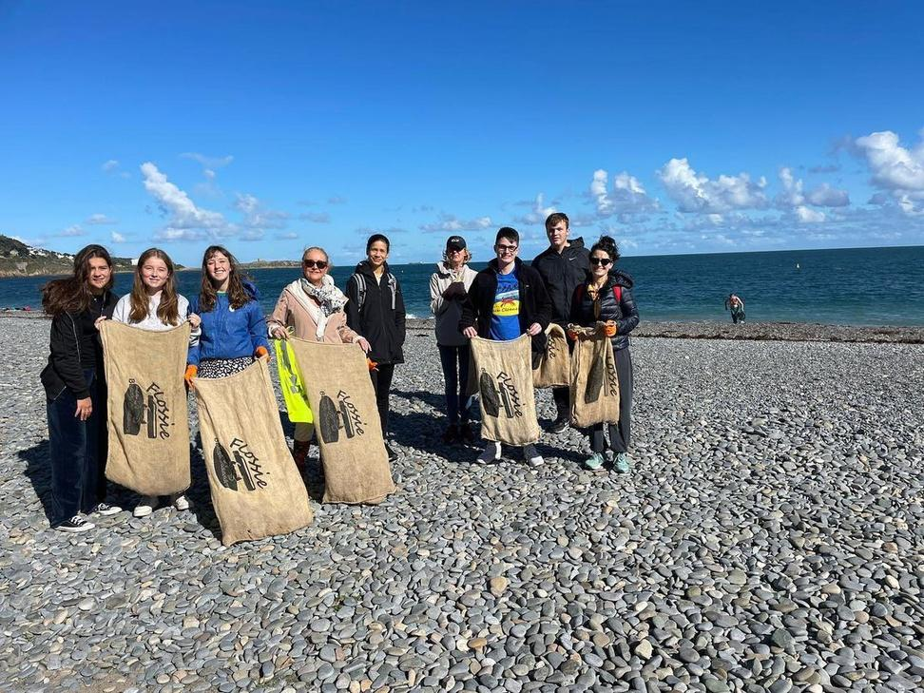
I I want to raise a generation of young, passionate environmentalists who will fight fearlessly to protect natural resources.
[W]e are not doing this for us, but we are doing it for the future generations from whom we have borrowed this planet.
Elizabeth Wathuti, Green Generation Initiative
Doing the work
Elizabeth Wathuti / X
Knowing you’re actively doing something by picking up rubbish, even if it’s a tiny piece, if you stop and think, this could’ve ended up in the stomach of something in marine life.
Flossie Donnelly (Irish Independent)
Flossie and the Beach Cleaners / Instagram
Notes:
4 activists in a circle locked on at Barton Moss

Slide 20
Doing the work
Elizabeth Wathuti / X
Flossie and the Beach Cleaners / Instagram
Stand up if you would
do voluntary work
to improve your environment.
Remain seated if not.
Notes:
4 activists in a circle locked on at Barton Moss

Slide 21
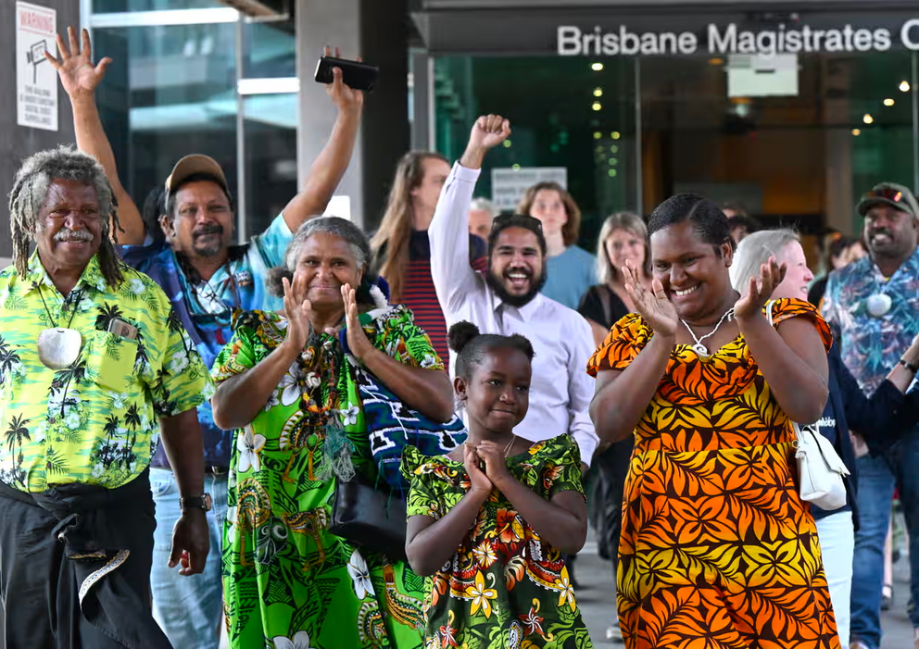
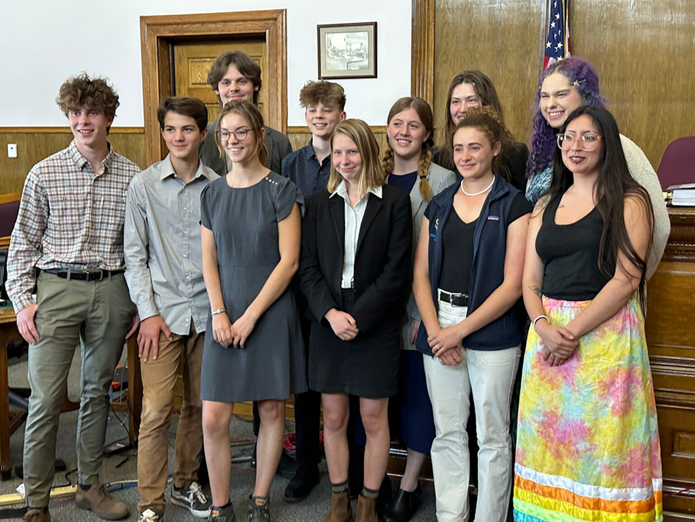
First Nations people, we’re the oldest surviving culture in the world so we have a lot to teach. It’s really about prioritising the future that younger people want to inherit … and it has to be guided by First Nations principles.
Murrawah Johnson, Youth Verdict (The Guardian)
Legal action
Darren England/AAP
I don’t want to have to fight my government for a liveable future. But it’s clear I must.
Taleah H., Plaintiff in Held vs. State of Montana
Daily Montana
Notes:
Youth Verdict took legal action against a new mine from Watarah Coal in the Galilee basin, contesting that the mine would infringe upon the human rights of future generations.

Slide 22
Legal action
Stand up if you would
take legal action
to force corporate or governmental climate action.
Remain seated if not.
Daily Montana
Notes:
Youth Verdict took legal action against a new mine from Watarah Coal in the Galilee basin, contesting that the mine would infringe upon the human rights of future generations.

Slide 23

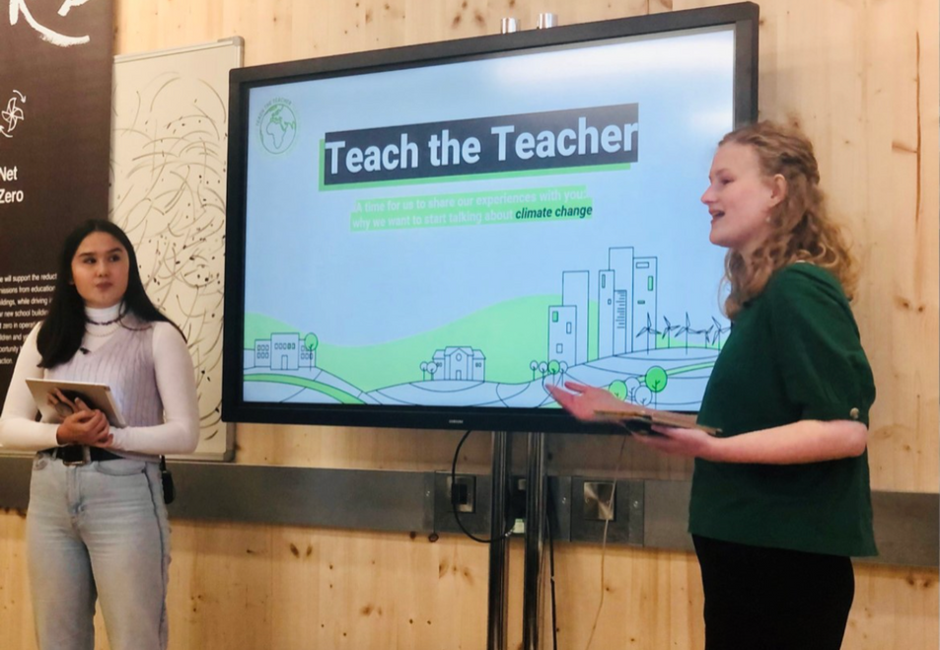
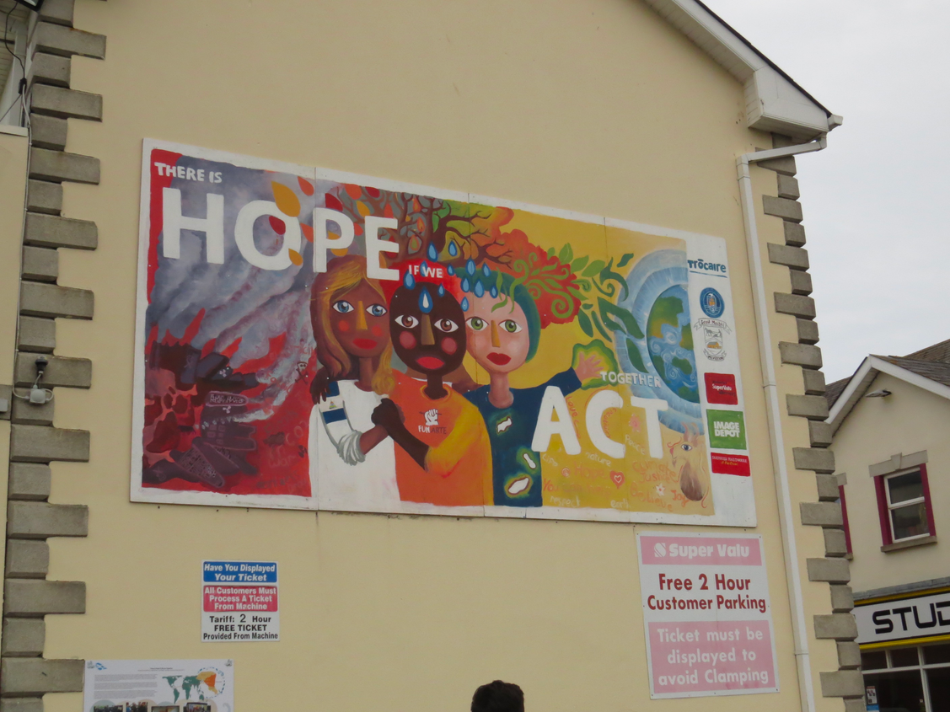

Others?
Lobbying
Teaching
Teach the Teacher
Trócaire 2016
Craftivist collective
Artivism/Craftivism
Notes:
Lobbying:
Citizens’ Climate Lobby recognizes that individual actions cannot solve the climate problem, but citizens can influence the political process. Their approach includes visiting congress people and engaging them in discussions about the need for a carbon fee, and writing op-eds and letters-to-the-editor.
Teaching:
Teach the Teacher trains groups of young people in schools to give their teachers lessons on climate change and what it’s like being a young person during the climate emergency. These lessons give students the skills to talk about climate and advocate for themselves, and shows teachers how they can take action in their teaching too.

Slide 24
Lobbying
Teaching
Teach the Teacher
Artivism/Craftivism
Craftivist collective
Trócaire 2016
Others?
Stand up if you would
do any of these
to encourage climate action.
Remain seated if not.
Notes:
Lobbying:
Citizens’ Climate Lobby recognizes that individual actions cannot solve the climate problem, but citizens can influence the political process. Their approach includes visiting congress people and engaging them in discussions about the need for a carbon fee, and writing op-eds and letters-to-the-editor.
Teaching:
Teach the Teacher trains groups of young people in schools to give their teachers lessons on climate change and what it’s like being a young person during the climate emergency. These lessons give students the skills to talk about climate and advocate for themselves, and shows teachers how they can take action in their teaching too.

Slide 25
  Protests / Strikes
  Disruption
  Voluntary work
  Legal action
  Lobbying
  Teaching others
  Artivism/craftivism
Which of these actions are likely to influence:
  governments?
  fossil fuel companies?
  the wider public?
Which are not? Why not?
Notes:
‘feedback’ - Discussion may have touched on effectiveness, winning public opinion, stopping companies from effectively using oil

Slide 26
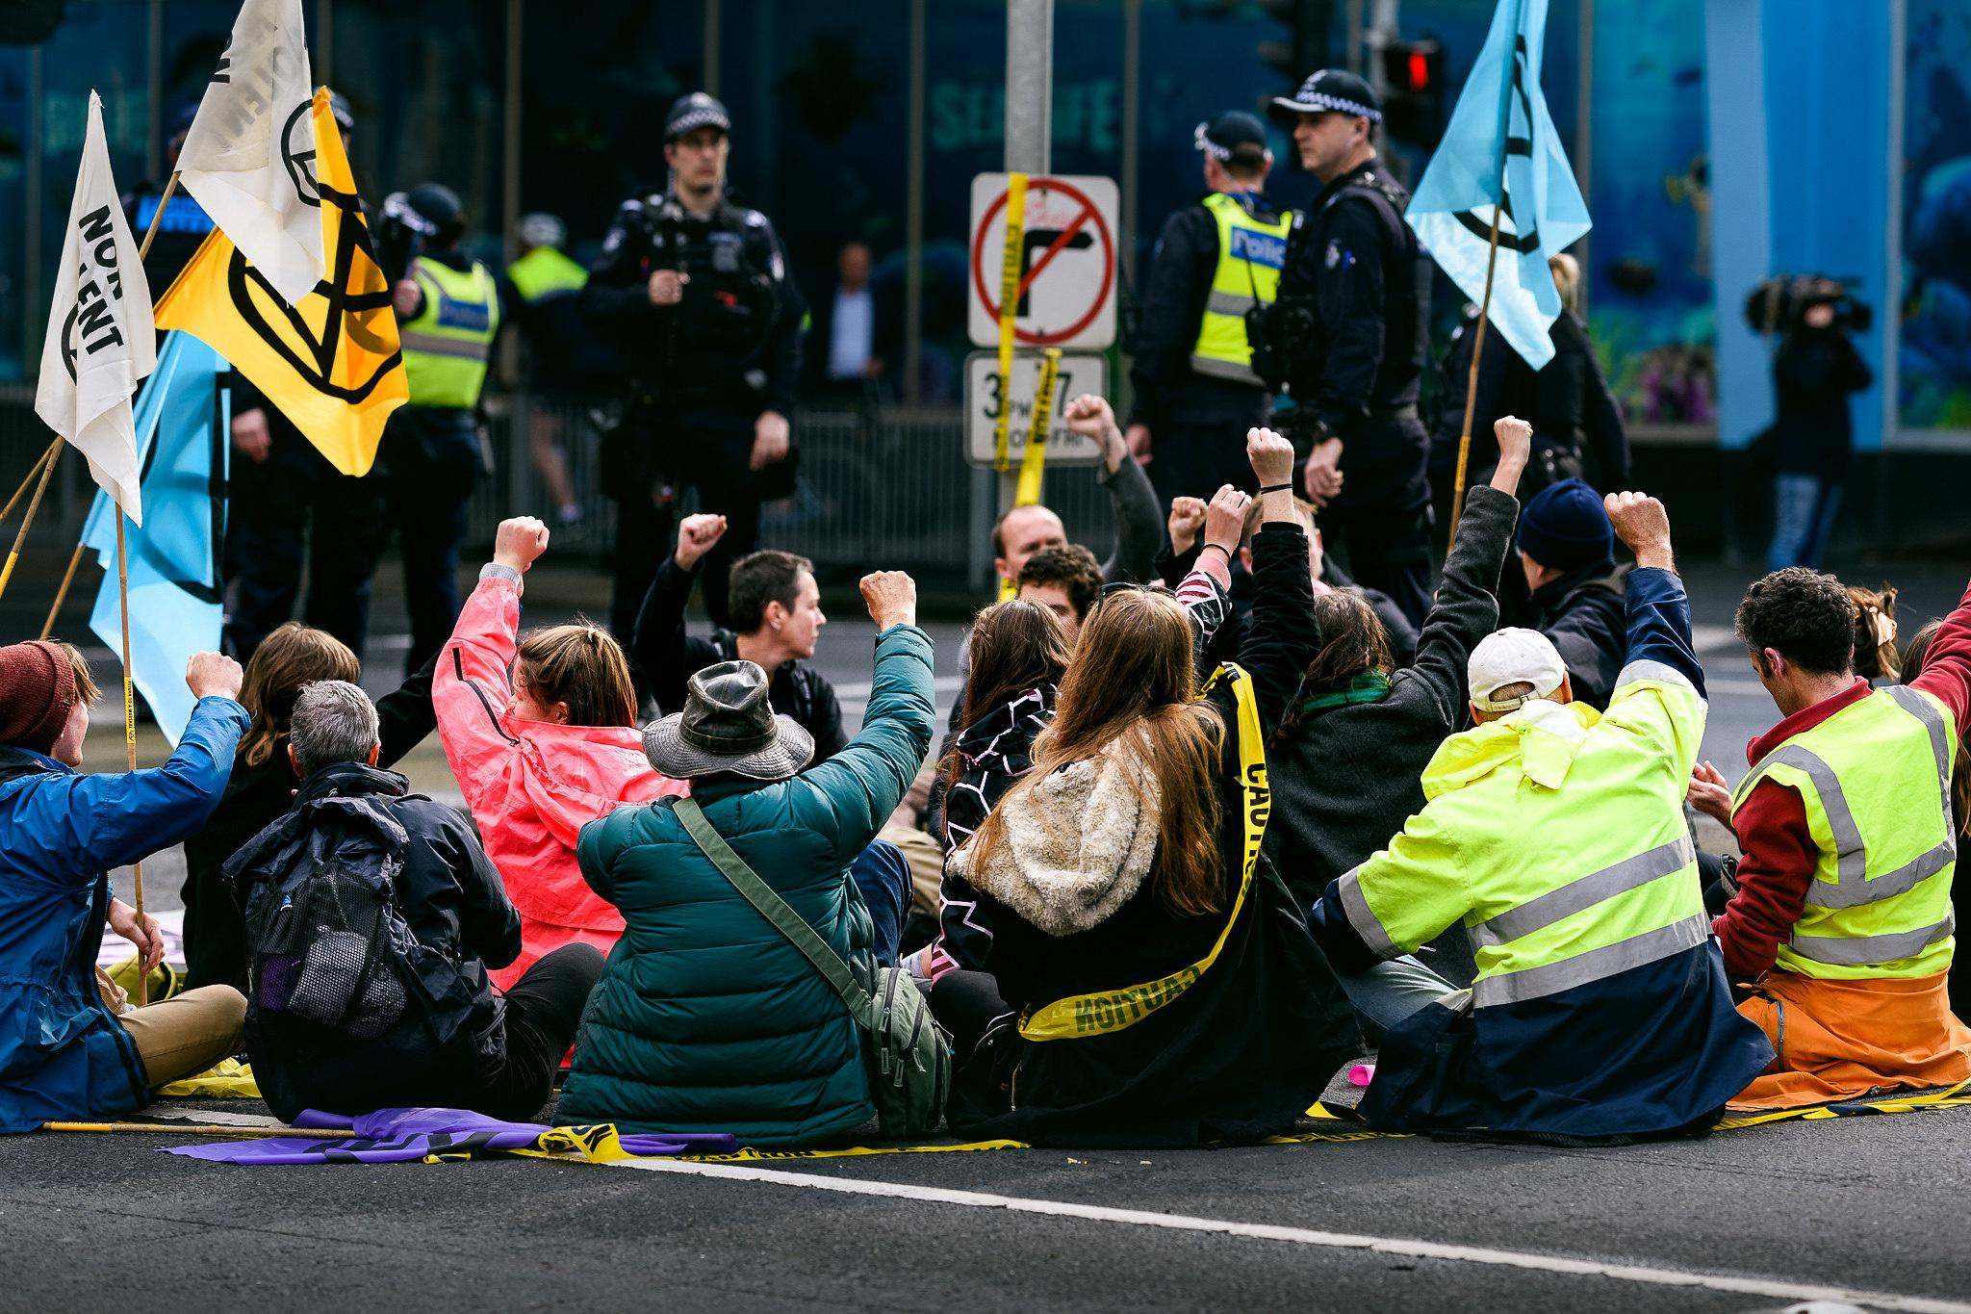

Is it right to engage in disruptive direct action?
Photo: julian meehan

Slide 27
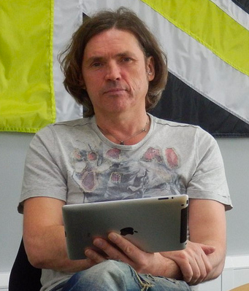
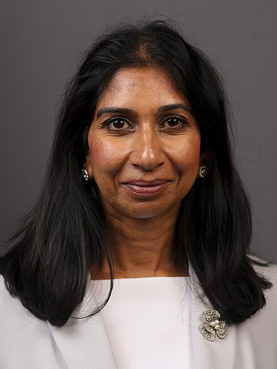
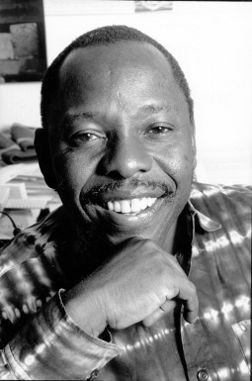
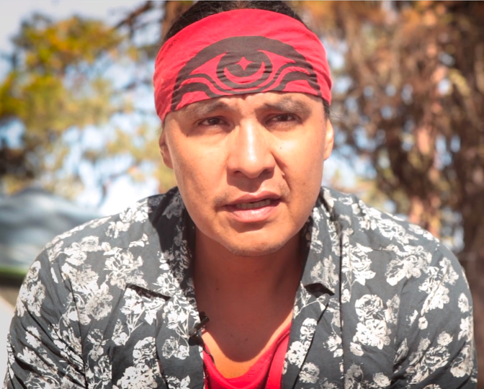
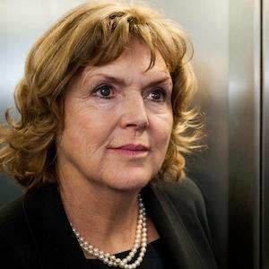
Dale Vince, Just Stop Oil donor
Suella Braverman MP, former UK Home Secretary
Ken Saro-wiwa, Nigerian writer & environmental activist
Chase Iron Eyes, Lakota Sioux attorney, activist and politician
Mary Lawlor, UN Special Rapporteur on Human Rights Defenders
Look at the quotes on the worksheet.
  What does each individual describe as the problem?
  Who believes that disruptive direct action is a way to address the problem? Why do they believe this?
  Who do you imagine has more power? Who has less power?
  What kind of world do the speakers want to see?

Slide 28
What are the arguments for and against engaging in disruptive direct action?
Discuss for 3 minutes
Arguments for | Arguments against

Slide 29
Arguments for | Arguments against
There’s a moral pressure to DO SOMETHING Taking these kinds of actions make people feel like they’re doing something Solidarity with the Global South & with future generations, Combat government apathy & non-responsiveness - even if it’s a negative response It puts pressure on vested interests such as the fossil-fuel lobby | Threat of prison Are you targeting the correct people with your action? Potential to alienate public e.g. by interrupting sport “It’s not my problem...” “This kind of action doesn’t influence anything...” Is disruptive direct action (e.g. suffragettes) truly more effective than peaceful protest (e.g. Ghandi & Indian independence).

Slide 30

Follow-on task
Take one of the actions suggested in the first part of the video.
  Find out about the next FFF school strike
  Do some voluntary work
  Teach another class group about the climate crisis
  Lobby a politician
  Create a piece of artivism or craftivism
Share on social media and tag it!
@IrishSchSusty @GAPIreland
#climateandnaturesummit

Slide 31

Get involved
Fridays for Future
fridaysforfuture.org/
@FFFIreland
Students Climate Action Network
@SCANIreland
Young Friends of the Earth
youngfoe.ie
@youngfoeireland
Flossie and the Beach Cleaners
https://flossieandthebeachcleaners.com/
@flossieandthebeachcleaners
Irish Schools Sustainability Network
issn.ie
@IrishSchSusty
Global Action Plan
globalactionplan.ie
@GAPIreland

Slide 32


Reflection
What have I learned about climate activism?
What is one interesting idea I’ve heard?
Did I have any strong feelings?
Have my feelings about activism changed? How?
What will I do after this session?
How will I behave differently?

Slide 33
Thanks for watching!
Funded by Irish Aid’s Worldwise Global Schools

Slide 34

Why aren’t we all activists??
Bonus:
Climate activism in the media
Funded by Irish Aid’s Worldwise Global Schools

Slide 35
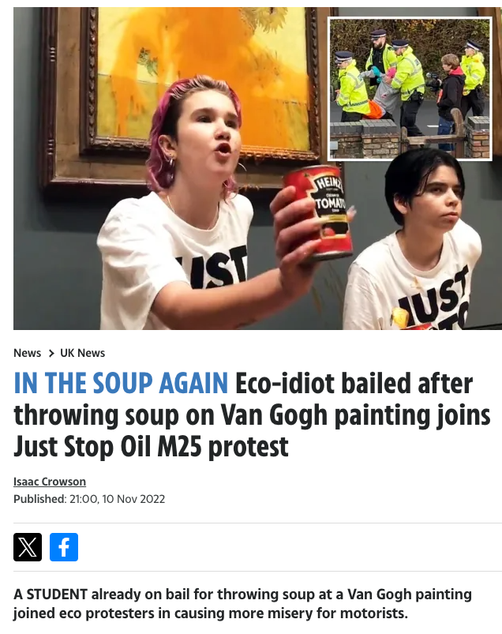
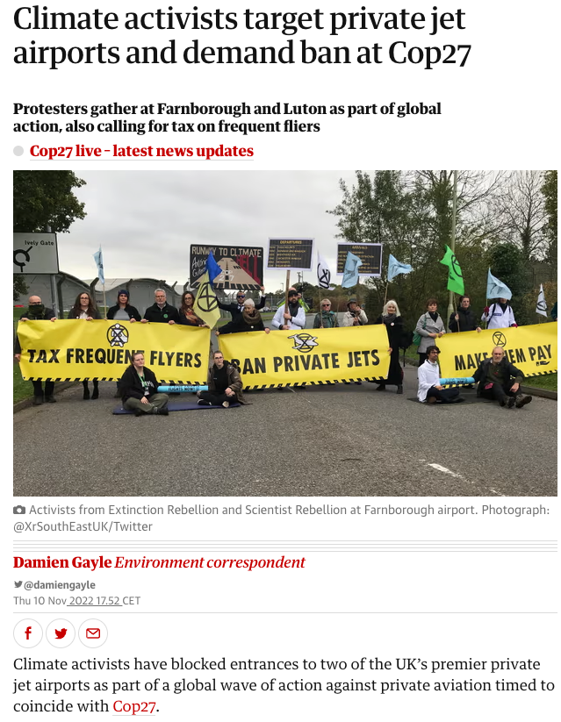
thesun.co.uk
theguardian.com

Slide 36
Words and images
  What words and images have been chosen?
  What ideas do they evoke?
Framing
  What does the story focus on?
  What ideas are presented? What is left out?
Implied reality
  What picture of the world does the story paint?
  What ‘facts’ does the story assume are ‘obvious’ and ‘true’?
Values
  What are the values that each story draws on?
  What does the writer of each story seem to believe?

Slide 37
Words and images
action and arrest
signage = demands
‘Eco-idiot’
‘Climate activists’
‘part of global action’
‘protest’

Slide 38
Framing
focus on individual
focus on collective
Refers to previous controversial action
Refers to current action
consequence -‘misery for motorists’
intention - ‘against private aviation’

Slide 39
Implied Reality
problem = private jets, frequent fliers
problem = ???
solution = soup, protest
solution = ban jets, tax fliers
already on bail = criminal?

Slide 40
Values
Protesting in this way (or for this cause) is idiotic
Protesting is a way to speak to power
These kind of actions aren’t justified
The climate crisis is worth taking action on

Slide 41
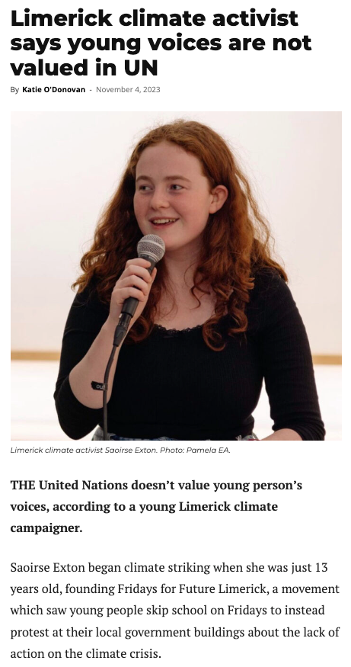
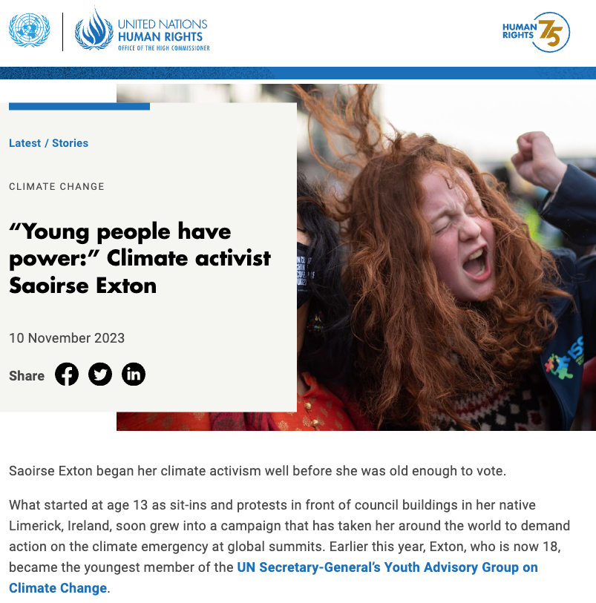
Your turn!

Slide 42
Follow-on task
Find & analyse a recent story about climate activism in the media.
Share on social media and tag it!
@IrishSchSusty @GAPIreland
#climateandnaturesummit

Slide 43
Reflection
What have I learned about climate activism?
What is one interesting idea I’ve heard?
Did I have any strong feelings?
Have my feelings about activism changed? How?
What will I do after this session?
How will I behave differently?

