Slide 1
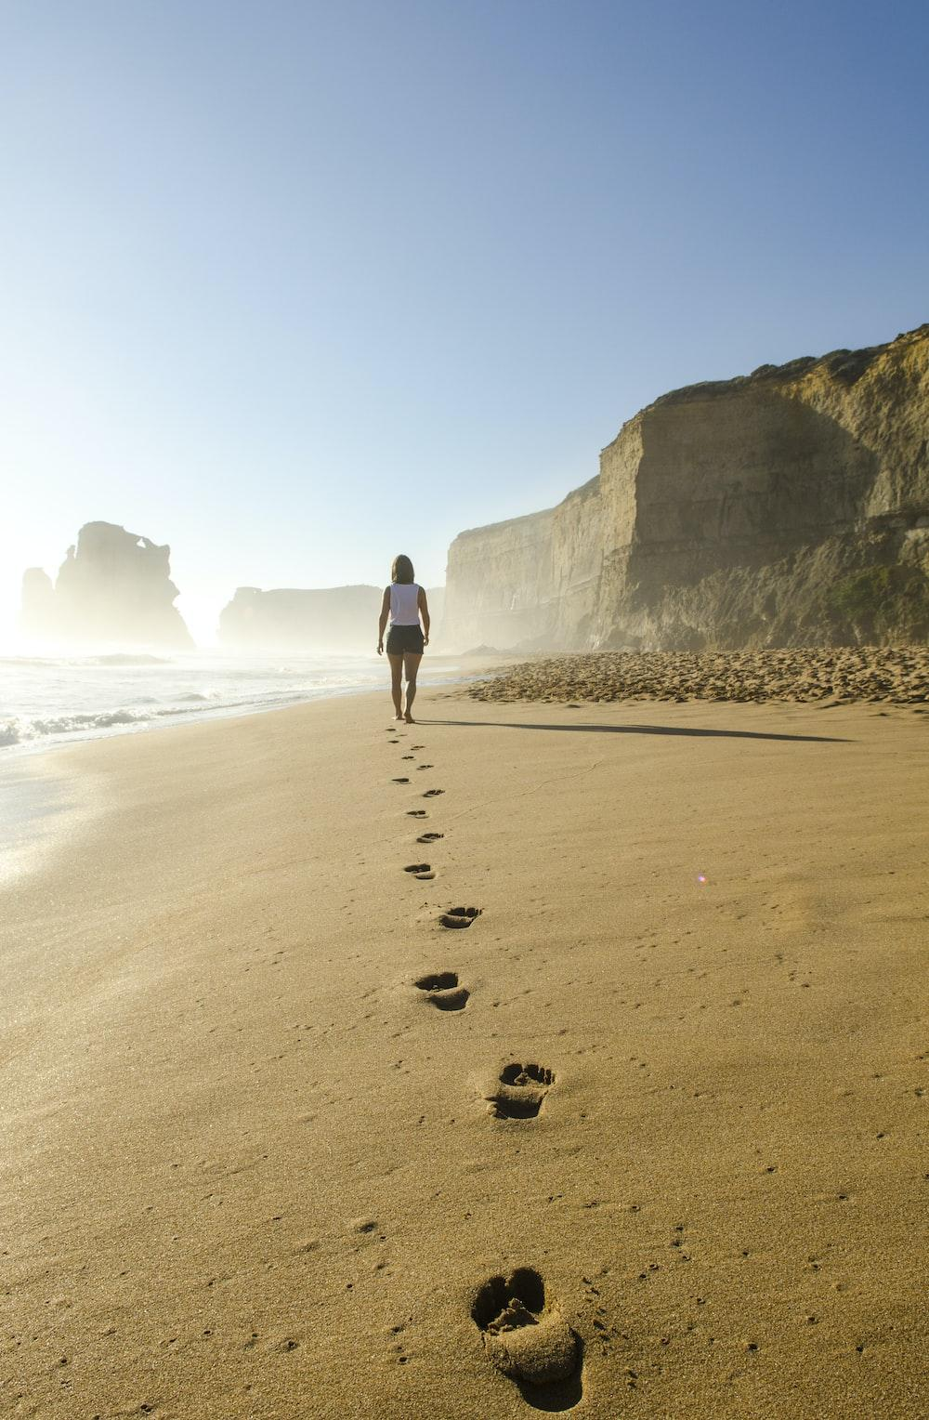
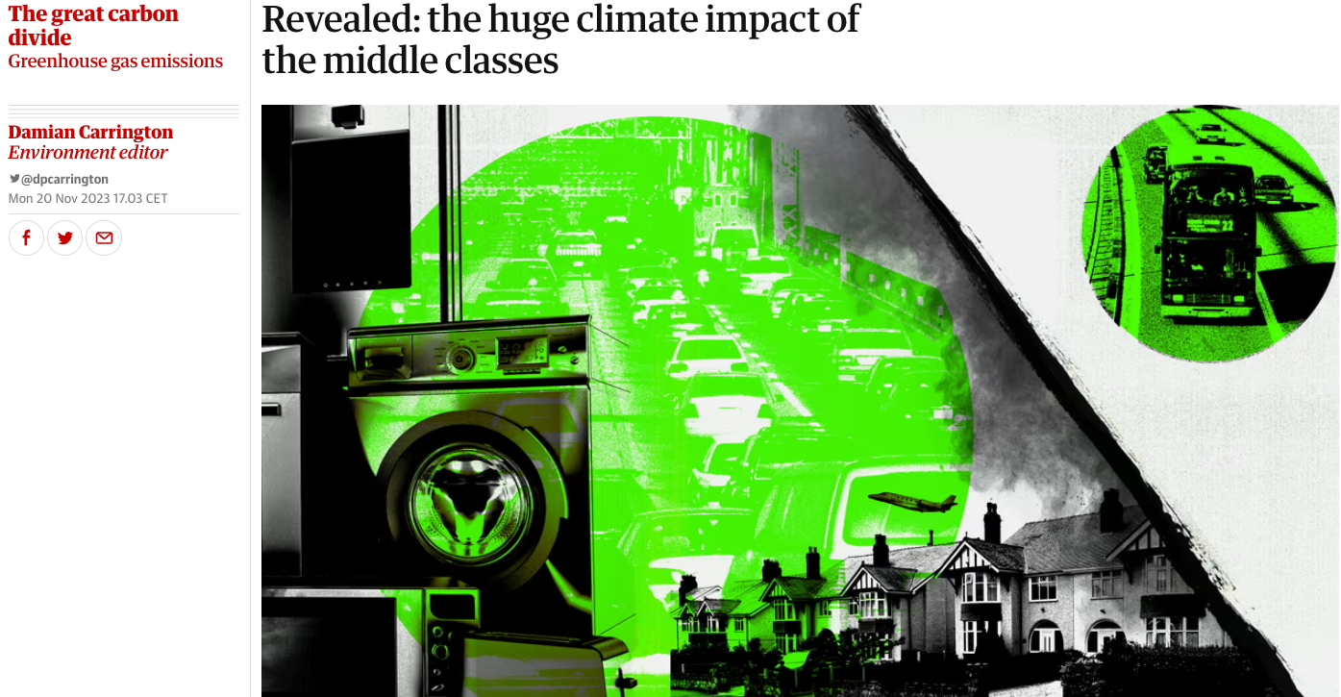
WALKING DEBATE
The world’s richest 10% include anyone paid more than about €36,700 a year. The 10% are responsible for half of all global emissions, making them key to ending the climate crisis.
Statement: Anyone earning over €36,700 a year in Ireland has a moral duty to lower their carbon emissions and should for example not be taking 3 or 4 flights a year.
Notes:
https://www.theguardian.com/environment/2023/nov/20/revealed-huge-climate-impact-of-the-middle-classes-carbon-divide#:~:text=The%20world's%20richest%2010%25%20encompasses,to%20ending%20the%20climate%20crisis.

Slide 2
WALKING DEBATE
I WANT A LIVEABLE FUTURE BUT I’M DOING NOTHING TO MAKE THAT HAPPEN. SO I THINK CLIMATE PROTESTORS ARE HEROES BECAUSE THEY ARE FIGHTING FOR ALL OF US! AT LEAST THEY ARE DOING SOMETHING!

Slide 3
WALKING DEBATE
DISRUPTIVE ACTION IS THE ONLY WAY TO INFLUENCE GOVERNMENT & FOSSIL FUEL COMPANIES.

